Slide 1
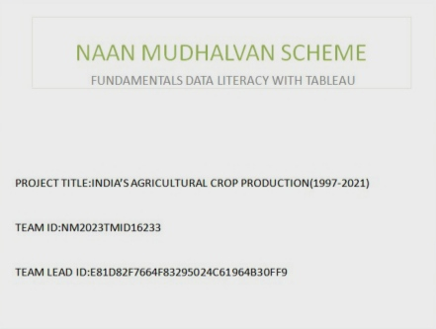

Slide 2
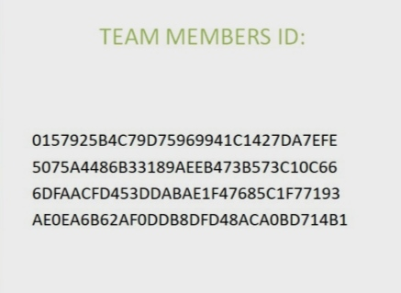

Slide 3
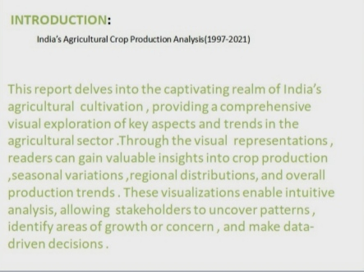

Slide 4


Slide 5
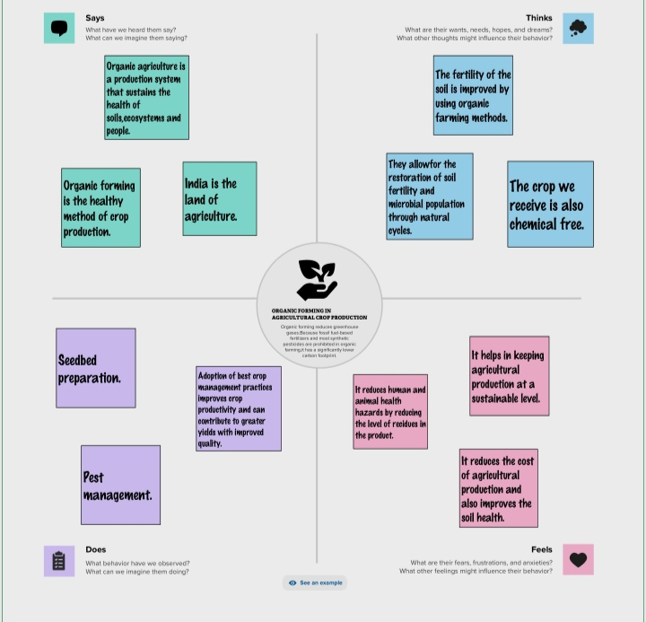

Slide 6
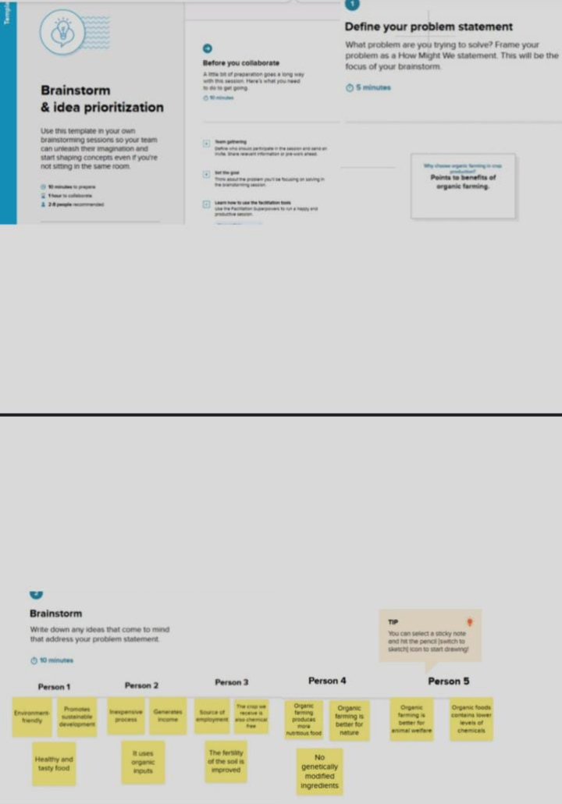

Slide 7
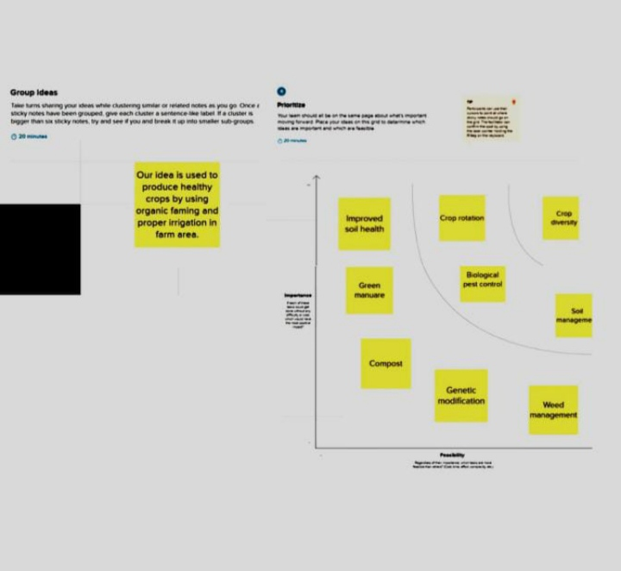

Slide 8
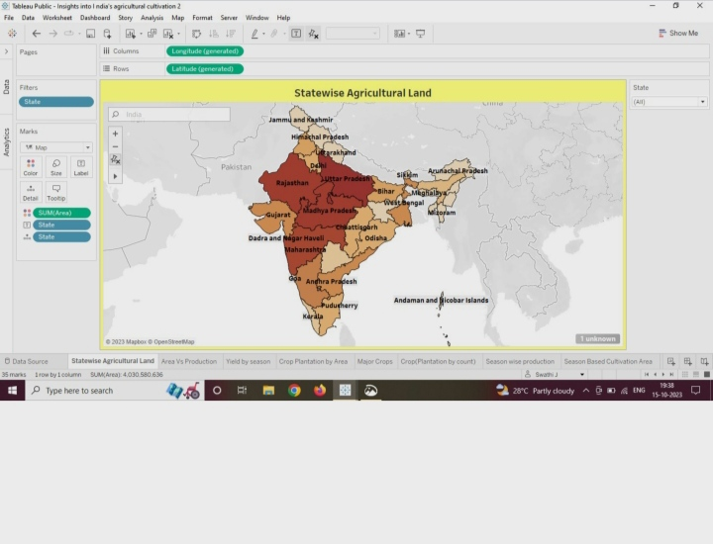
Statewide Agricultural Land
Notes:
Statewide Agricultural Land

Slide 9
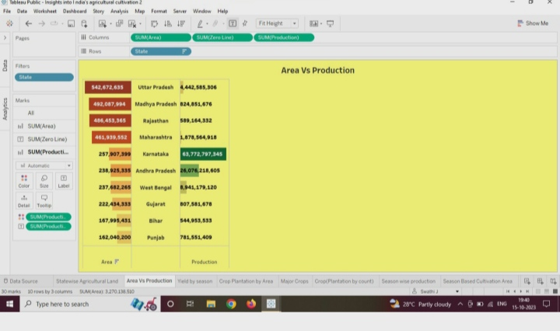
Area Vs Production

Slide 10
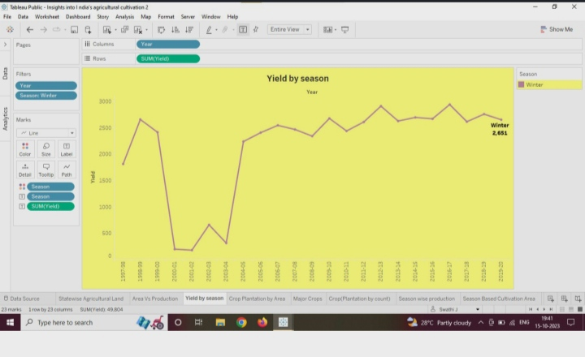
Yield by season

Slide 11
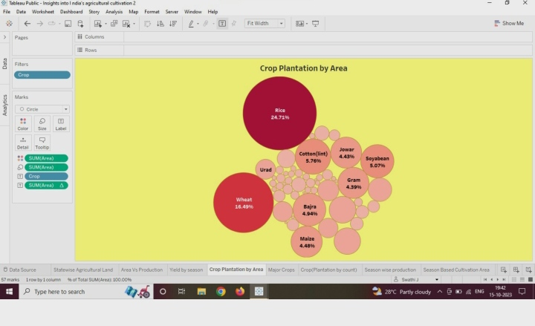
Crop Plantation by Area

Slide 12
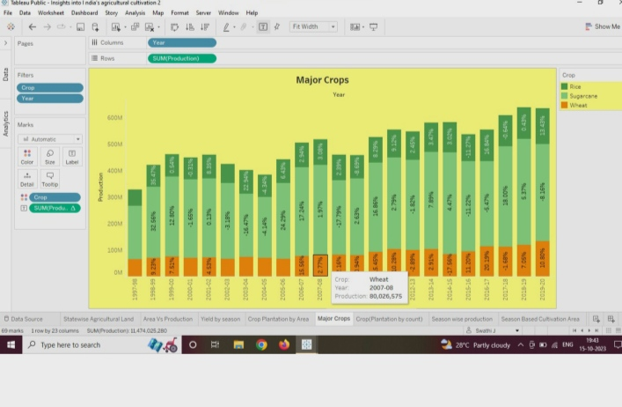
Major crops

Slide 13
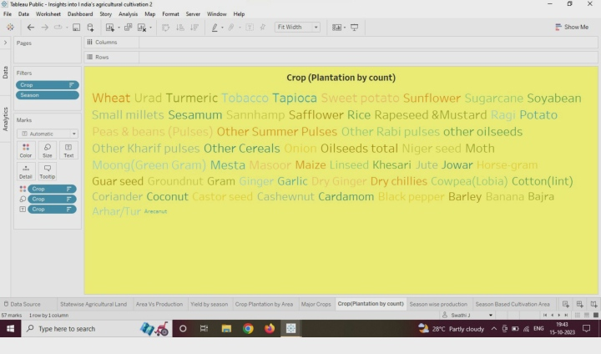
Crop (Plantation by count )

Slide 14
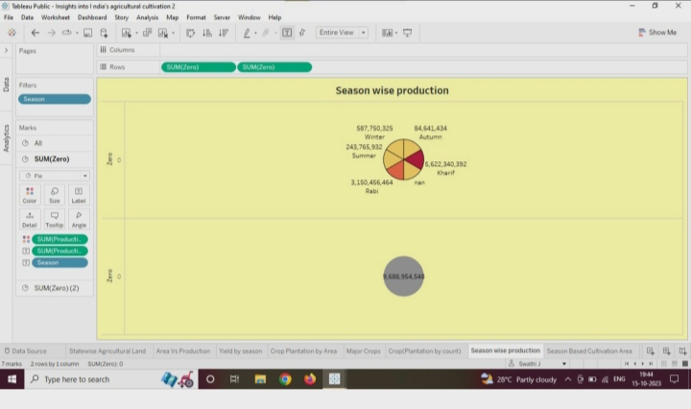
Season wise production

Slide 15
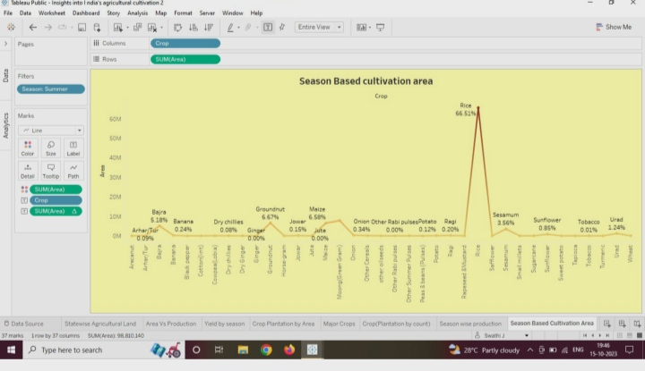
Season Based Cultivation area

Slide 16
DASHBOARD

Slide 17
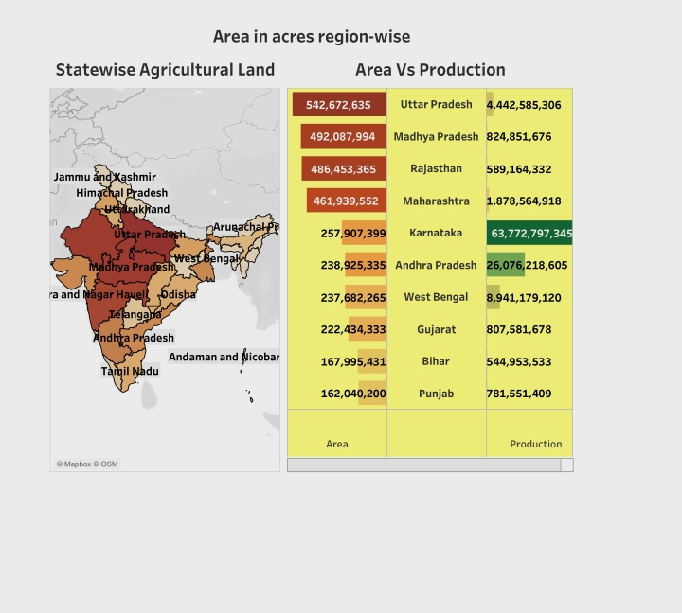
Dashboard 1

Slide 18
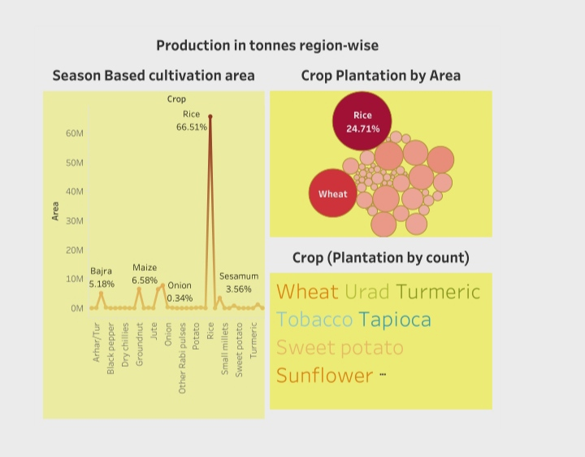
Dashboard 2

Slide 19
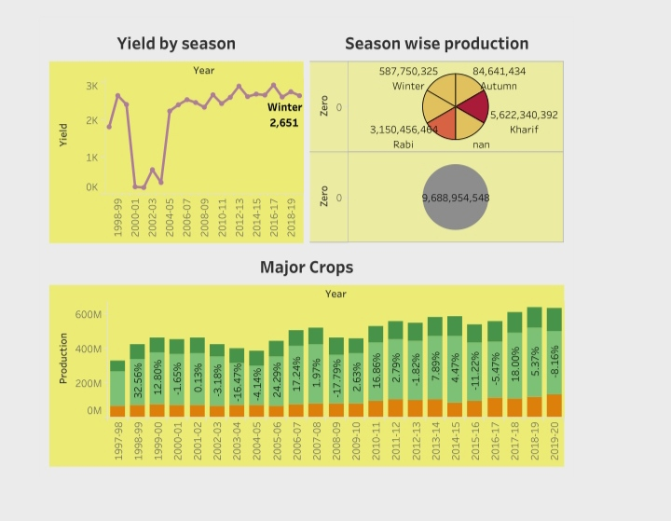
Dashboard 3

Slide 20
STORY

Slide 21
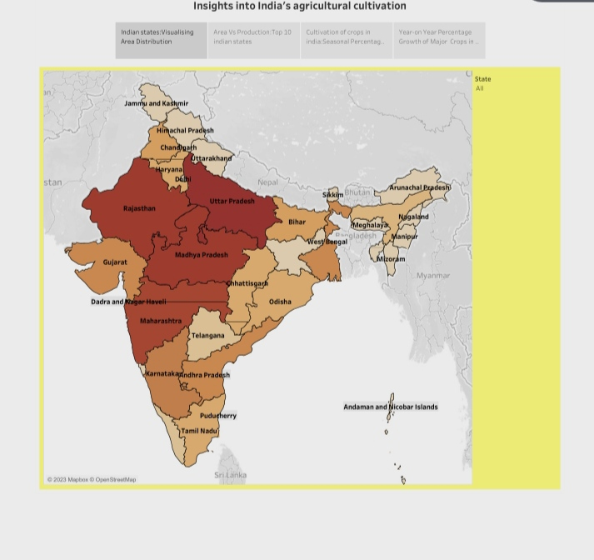
Insights into India‘s agricultural cultivation

Slide 22
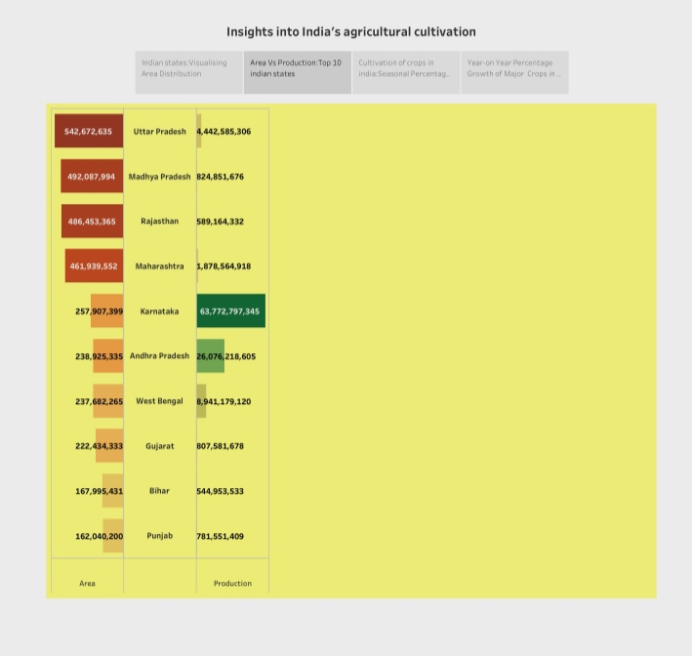
Insights into India’s agricultural cultivation

Slide 23
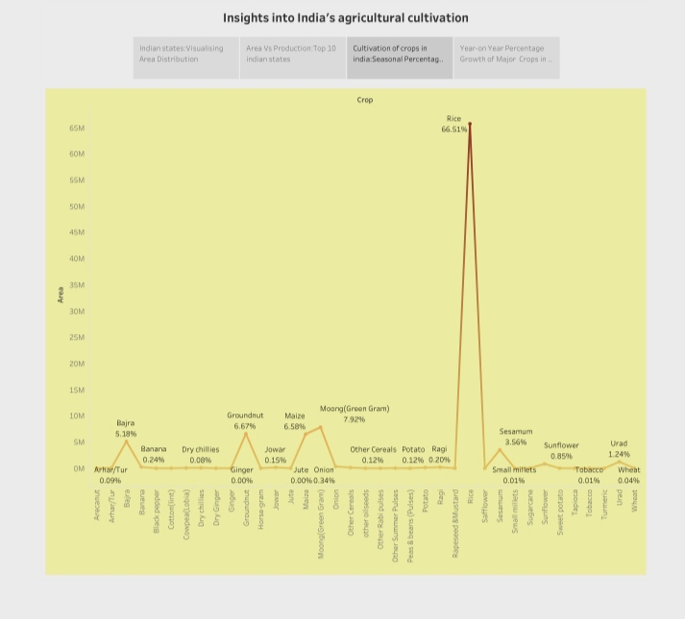
Insights into India’s agricultural cultivation

Slide 24
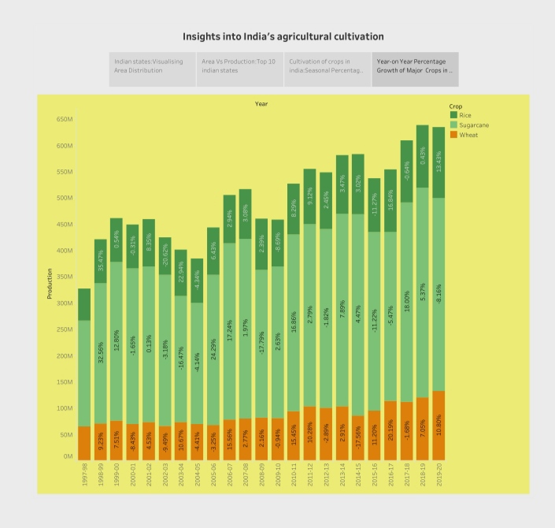
Insights into India’s agricultural cultivation

Slide 25
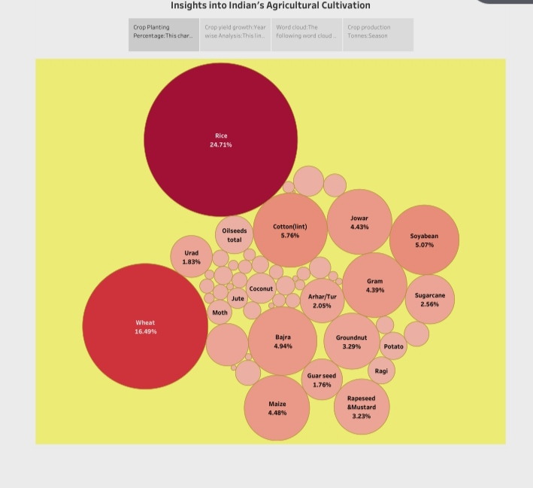
Insights into India’s agricultural cultivation

Slide 26
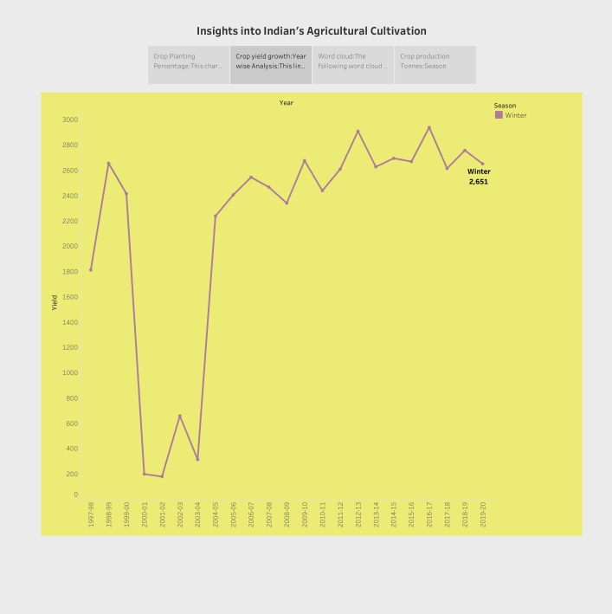
Insights into Indian’s agricultural cultivation

Slide 27
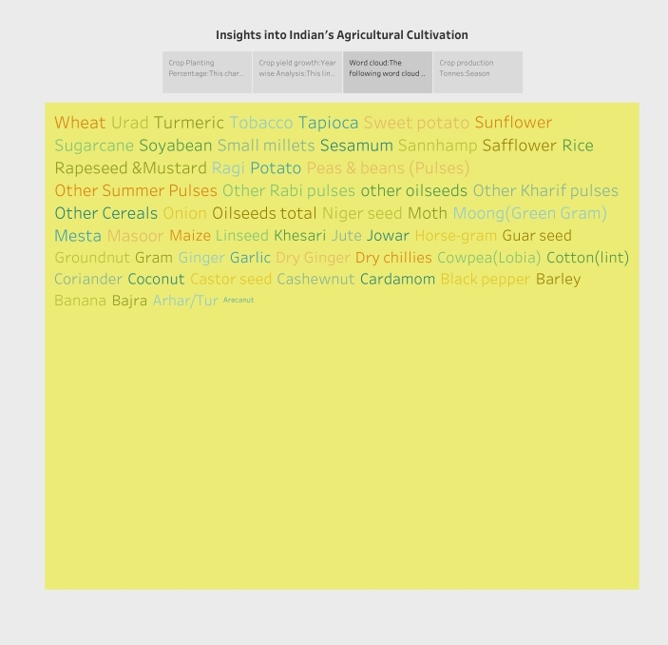
Insights into India’s agricultural cultivation

Slide 28
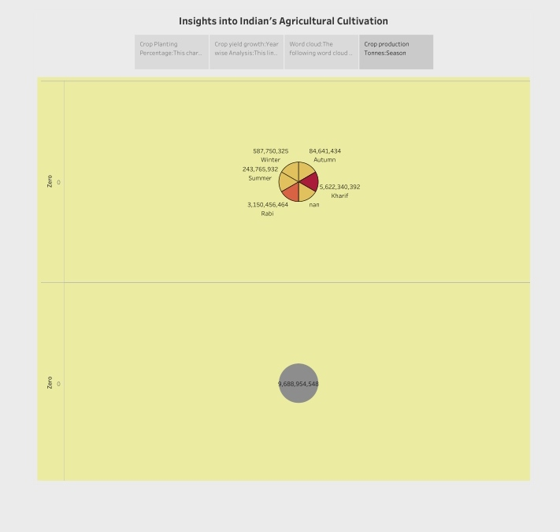
Insights into India’s agricultural cultivation

Slide 29
PUBLISHING

Slide 30
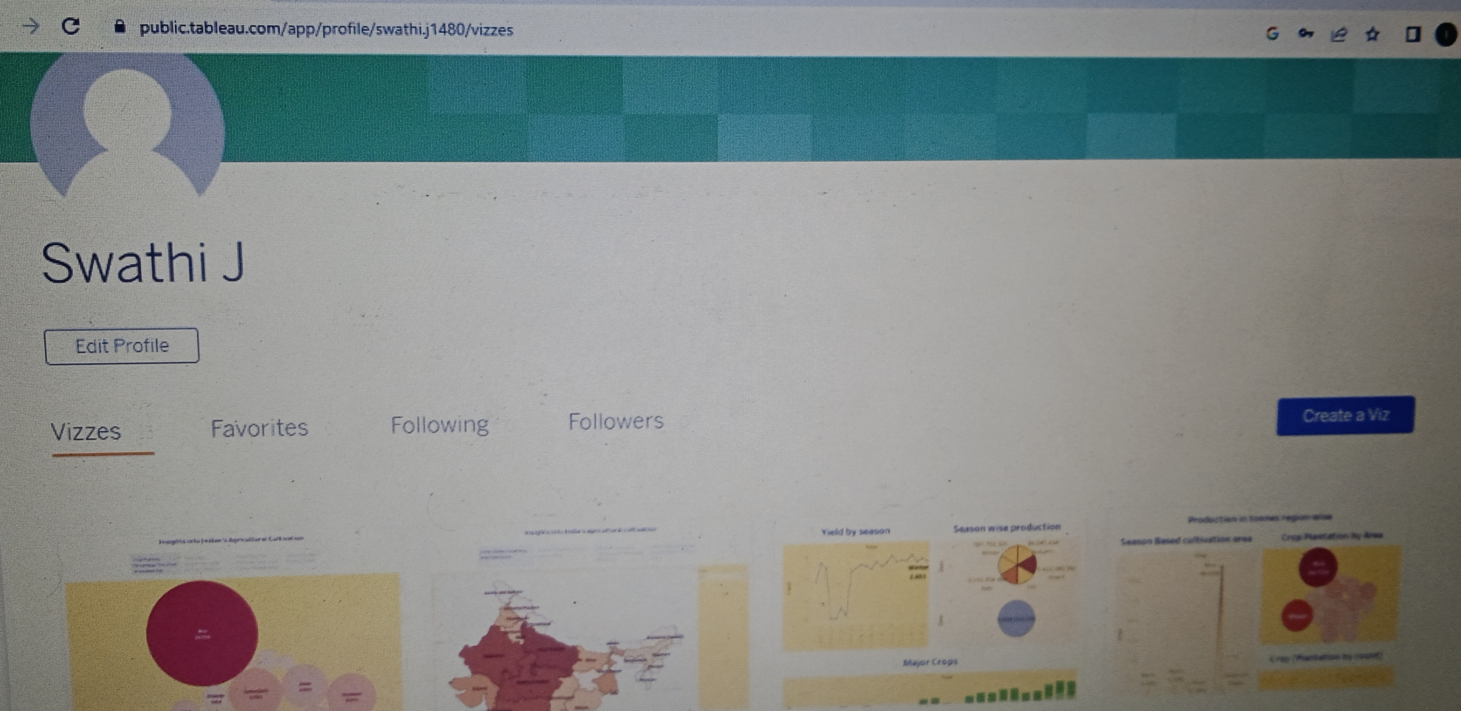

Slide 31
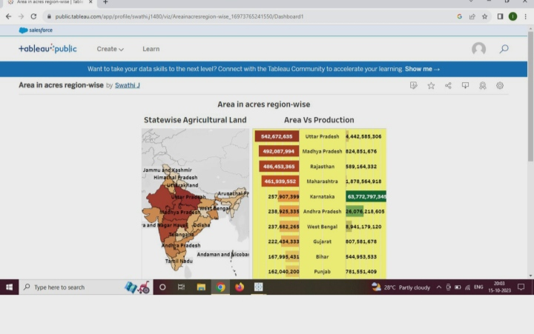

Slide 32
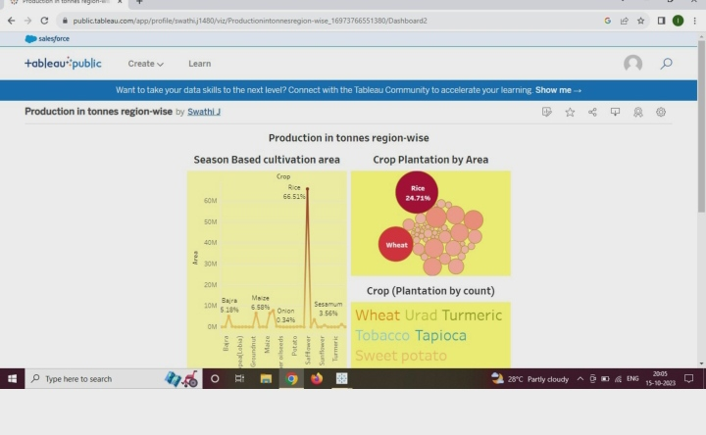

Slide 33
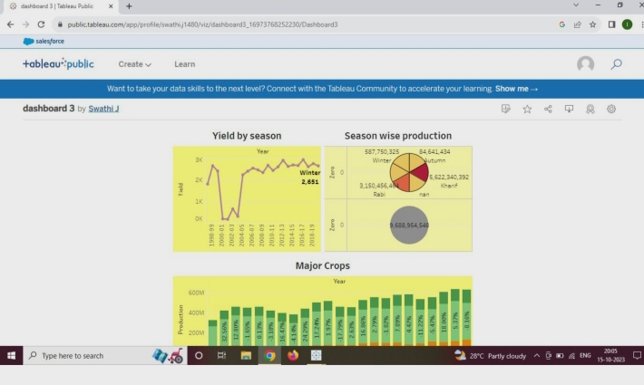

Slide 34
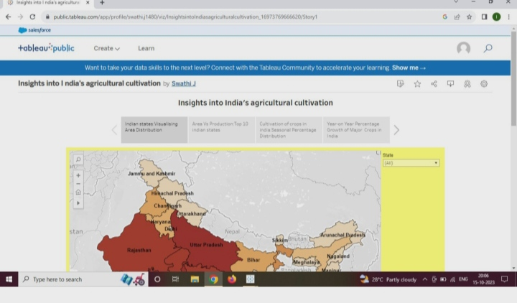

Slide 35
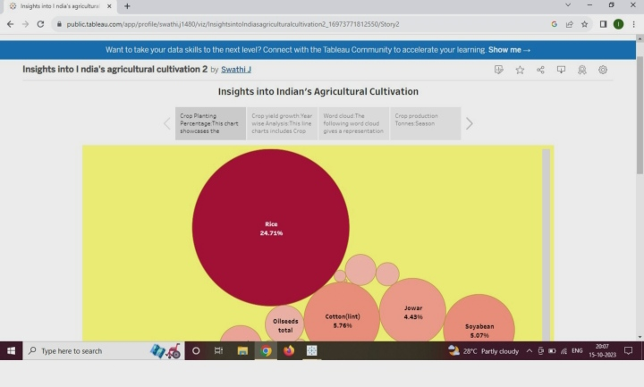

Slide 36
THANK YOU

